Slide 1
The History of DRAM Technology
Xixi Chen
2020-04-11

Slide 2
What's DRAM?
DRAM: usually means DDR SDRAM
Double Data Rate
DDR: the other technology may use SDR or QDR.
Synchronous
I/O and control signals are synchronized with an external clock.
The originally dram is Asynchronous.
Dynamic
Dram Cell is capacitor, leak all the time, should refresh periodically.
Random Access Memory
Access Memory by any address, no need to sequential.

Slide 3
SDR DDR QDR
SDR DRAM uses SDR.
(LP)DDR DDR2 DDR3 DDR4 DDR5 use DDR.
GDDR5X uses DDR or QDR.

Slide 4
DDR or QDR of GDDR5X

Slide 5
Why DRAM not use TDR/QDR?
Triple or quadruple transfer points in a single sine wave would be possible but would require a lot more work to determine the correct timing as data would need to transfer the next bit of data not on just an easy to determine peak. its just not simple/reliable so they don't do it(remember the receiving devices decoder has to match the same timing of the sending device or it could possible read the data to late/early).

Slide 6

Asynchronous DRAM is an older type of DRAM used in the first personal computers. It is called "asynchronous" because memory access is not synchronized with the computer system clock. Modern PCs use SDRAM(synchronized DRAM) that responds to read and write operations in synchrony with the signal of the system clock.
Why was it phased out?
When a program issued an instruction to access data in asynchronous memory, the data would be accessible on the system bus some time later, but this time was variable and not guaranteed. This was acceptable on older systems, until they reached speeds of about 66 MHz.

Slide 7

Asynchronous DRAM
Conventional DRAM is controlled asynchronously, requiring the system designer to manually insert wait states to meet the specifications of the device. Timing depends on the speed of the DRAM and is independent of the system bus speed. It is these timing limitations that led to the development of the SDRAM.
SDRAM is essentially a fast DRAM with a high-speed synchronous interface. I/O‘s and control signals are synchronized with an external clock, making new options available to the designer. Simplified interface circuitry, as well as high-bandwidth data throughput can be achieved using SDRAM over conventional DRAM.

Slide 8
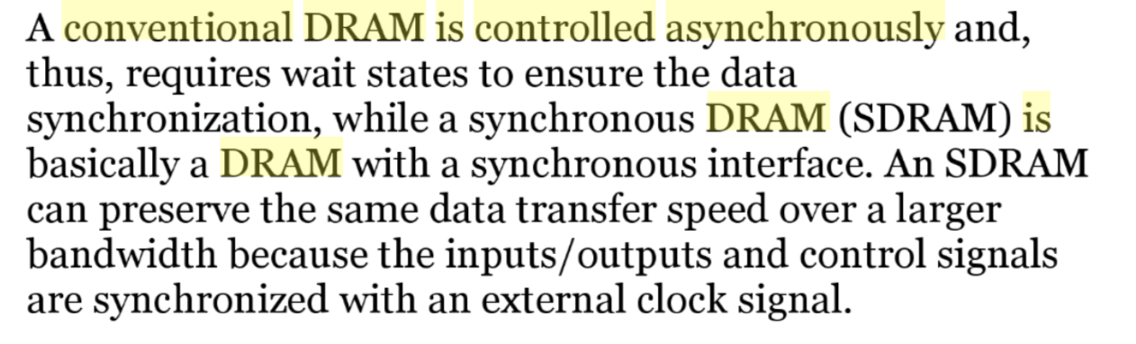

Slide 9

Dynamic
DRAM is called dynamic, because it must be refreshed all the time or it will lose the data which it is supposed to be storing.
Refreshing DRAM means reading the data from the DRAM and directly writing them back to the DRAM. DRAM is made up of millions of very small capacitors. Each of these capacitors has a transistor to let energy in and out. The capacitor slowly loses energy, and if the DRAM is not refreshed, in the end one or more of the capacitors will let so much energy out, that for example a 1 will become a 0, so data will be lost or corrupted. Almost all computers refresh their DRAM many times per second.
You can compared to Static RAM, which doesn’t need to refresh to retain the data.

Slide 10
Random Access Memory
When Row and Column Address is fixed, the real address in dram array is confirmed.
It’s like Two-Dimension Array.

Slide 11
JEDEC

Slide 12
Needs to be vs Must be
Needs to be: an advice!
Must to be: a must!

Slide 13
DDR GDDR HBM HMC 3D Stack

Slide 14
LPDDR2 S2/S4/N
S2 means 2n prefetch, S4/N means 4n prefetch.
LPDDR2-S2 also uses a double data rate architecture on the DQ pins to achieve high speed operation. The double data rate architecture is essentially a 2n prefetch architecture with an interface designed to transfer two data bits per DQ every clock cycle at the I/O pins. A single read or write access for the LPDDR2-S2 effectively consists of a single 2n-bit wide, one clock cycle data transfer at the internal SDRAM core and two corresponding n-bit wide, one-half- clock-cycle data transfers at the I/O pins.
LPDDR2-S4 and LPDDR2-N also use a double data rate architecture on the DQ pins to achieve high speed operation. The double data rate architecture is essentially a 4n prefetch architecture with an interface designed to transfer two data bits per DQ every clock cycle at the I/O pins. A single read or write access for the LPDDR2-S4 and LPDDR2-N effectively consists of a single 4n-bit wide, one clock cycle data transfer at the internal SDRAM/NVM core and four corresponding n-bit wide, one-half-clock-cycle data transfers at the I/O pins.

Slide 15
LPDDR3E
Core Freq: 133MHz

Slide 16
Commercial vs Industrial Dram

Slide 17
DRAM Pins

Slide 18
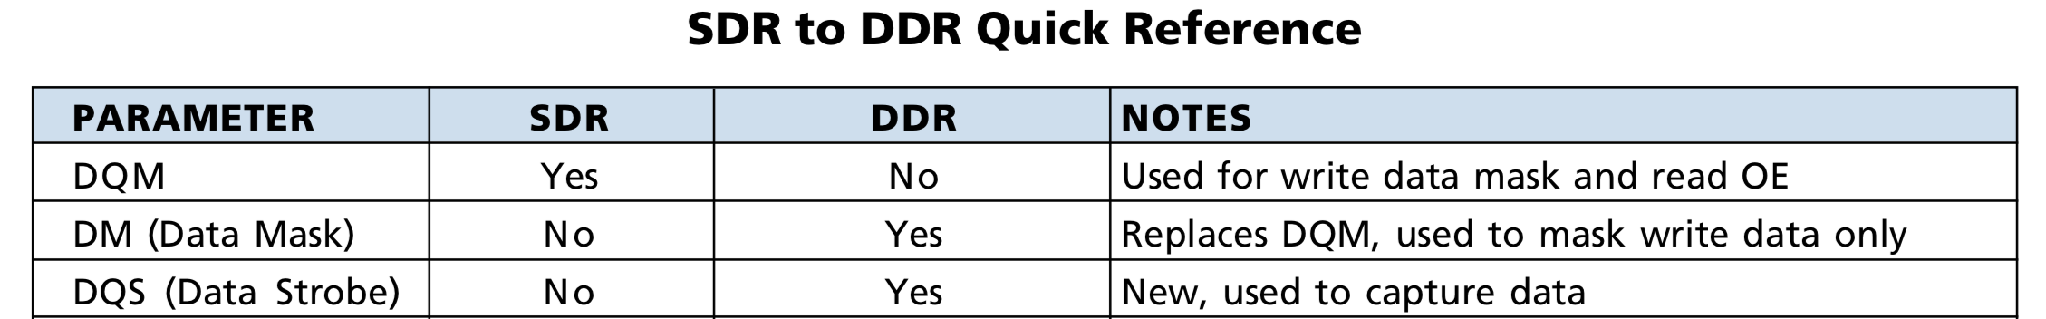
Clock Synchronous vs Source Synchronous
The SDR memory data interface is a fully synchronous design where the data is only captured on the positive clock edge.
The DDR memory data is a true source synchronous design, where the data is captured twice per clock cycle with a bidirectional data strobe.

Slide 19
Why CK is differential?
To increase accuracy caused by clock jitter, a differential clock was added to DDR. SDR devices use the midpoint of the rising clock edge to latch data and thus are exposed to drift. DDR uses the crossing point of CK and CK#. Using the crossing point instead of the midpoint helps negate the affects of jitter and increase margins.

Slide 20
Output Enable
OE: Output Enable. This is an additional signal that controls output to the data I/O pins. The data pins are driven by the DRAM chip if RAS and CAS are low, WE is high, and OE is low. In many applications, OE can be permanently connected low (output always enabled), but it can be useful when connecting multiple memory chips in parallel.
It’s phased out.

Slide 21
CKE vs Rank
CKE is often together with Rank.

Slide 22
SDR CA vs DDR CA
LPDDR3: DDR CA
DDR3/DDR4/LPDDR4: SDR CA
SDR CA:
easier to maintain good signal integrity.

Slide 23
Where does DQS come from?
For higher data rate.

Slide 24
Why 1 DQS matches 8 DQ?
The number of DQS(n) is because if you try and delay match a very large bus it is much harder to match all lines closely whereas only having to delay match 8 DQ lines, 1 DM and the DQS(n) means you are only having to delay match 11 signals instead of something like 80 signals for a 64-bit wide DDR DRAM interface.
Actually, for DQS/DQ matching, it’s different one by one. Some DIMM module uses 4 DQ with 1 DQS, and some graphic controller uses one ~ four DQS per 32 bits.

Slide 25
RDQS/TDQS
For x4 and x8 design.

Slide 26
Edge Aligned vs Center Aligned
For easy control of the delay circuit, which can be done only by controller.

Slide 27
Why DQ not differential?
DQ is a data signal, and can tolerate more skew than DQS.

Slide 28
Data Mask(DM)
Because dram burst length is often more than one byte, so, if we only write one byte(or less than the burst unit), the other bytes must be kept.
So, DM is a must.

Slide 29
Synchronous Reset vs Asynchronous Reset
Synchronous reset means reset is sampled with respect to clock. In other words, when reset is enabled, it will not be effective till the next active clock edge.
In asynchronous reset, reset is sampled independent of clk. That means, when reset is enabled it will be effective immediately and will not check or wait for the clock edges.

Slide 30
CPU Data Width vs Dram Data Width
Early PC, CPU Data Width is equal to dram data width.
Moden PC and moden phone don’t need they are equal.
Moden transfer protocol can handle the mismatch of data width, eg: AXI.

Slide 31
DRAM Internal Structure

Slide 32
VDD1/VPP
Vdd1: Core Power: memory array power.
Vpp: DDR4 word line power.
A special high-voltage supply that supplies the potential and energy for altering the state of certain nonvolatile memory arrays. On some devices, the presence of VPP also acts as a program enable signal (P).
References:
JESD21-C, 1/97
For DDR4, JEDEC decided to introduce an external VRM that provides a 2.5v electrical high voltage for the word line (row access). Since the word line voltage is no longer pumped up from the DDR voltage (like it was for DDR3), the inefficiencies of pumping up the DDR voltage are gone, and instead you get power savings.

Slide 33
Why Dram Core/IO Power are isolate?
Since large amounts of current are sourced and sunk into the SDRAM during read and write operations, switching noise can be generated which may have an adverse effect on the memory array. Separate power inputs are provided for the I/O signals and the memory array, isolating the memory cells from possible data corruption.

Slide 34
Multi Channel
Multi channel can improve bandwidth because multi data transfer at the same time.
Thereway, the controllers must support multi channel.

Slide 35
Where does Rank come from?
The term rank was created and defined by JEDEC, the memory industry standards group.

Slide 36
Multi Rank
Increasing the number of ranks is mainly intended to increase the memory density per channel. Too many ranks in the channel can cause excessive loading and decrease the speed of the channel. Also some memory controllers have a maximum supported number of ranks.

Slide 37
Where does Bank come from?
Multiple banks are provided so we can be simultaneously working on different requests.

Slide 38
Why 8 banks?
2 banks or 4 banks exsit in early dram.
8 banks seems to be the best choice.

Slide 39
Sense Amplifier/Row buffer
Sense Amplifier’s another name is “Row Buffer”.
Why need Sense Amplifier?
Bit cells of SRAM are made very small to reduce the cost. Thus, turning bit-lines to logic 0 or 1 using small cells require much longer time.
To solve these issues both bit-lines are precharged to Vdd (logic 1). A single cell is electrically connected to bit-lines for a small time to make a small difference in voltages. Later, the sense amplifier senses that difference and convert that small difference to logic 1 and logic 0.
1T1C Structure : read from DRAM is destructive, so recover memory info is a must, sense amplifier occurs.

Slide 40
Row buffers act as a cache within DRAM
Row buffer hit: must only move data from row buffer to pins.
Empty row buffer access: must first read arrays, then move data from row buffer to pins.
Row buffer conflict: must first writeback the existing row, then read new row, then move data to pins.

Slide 41
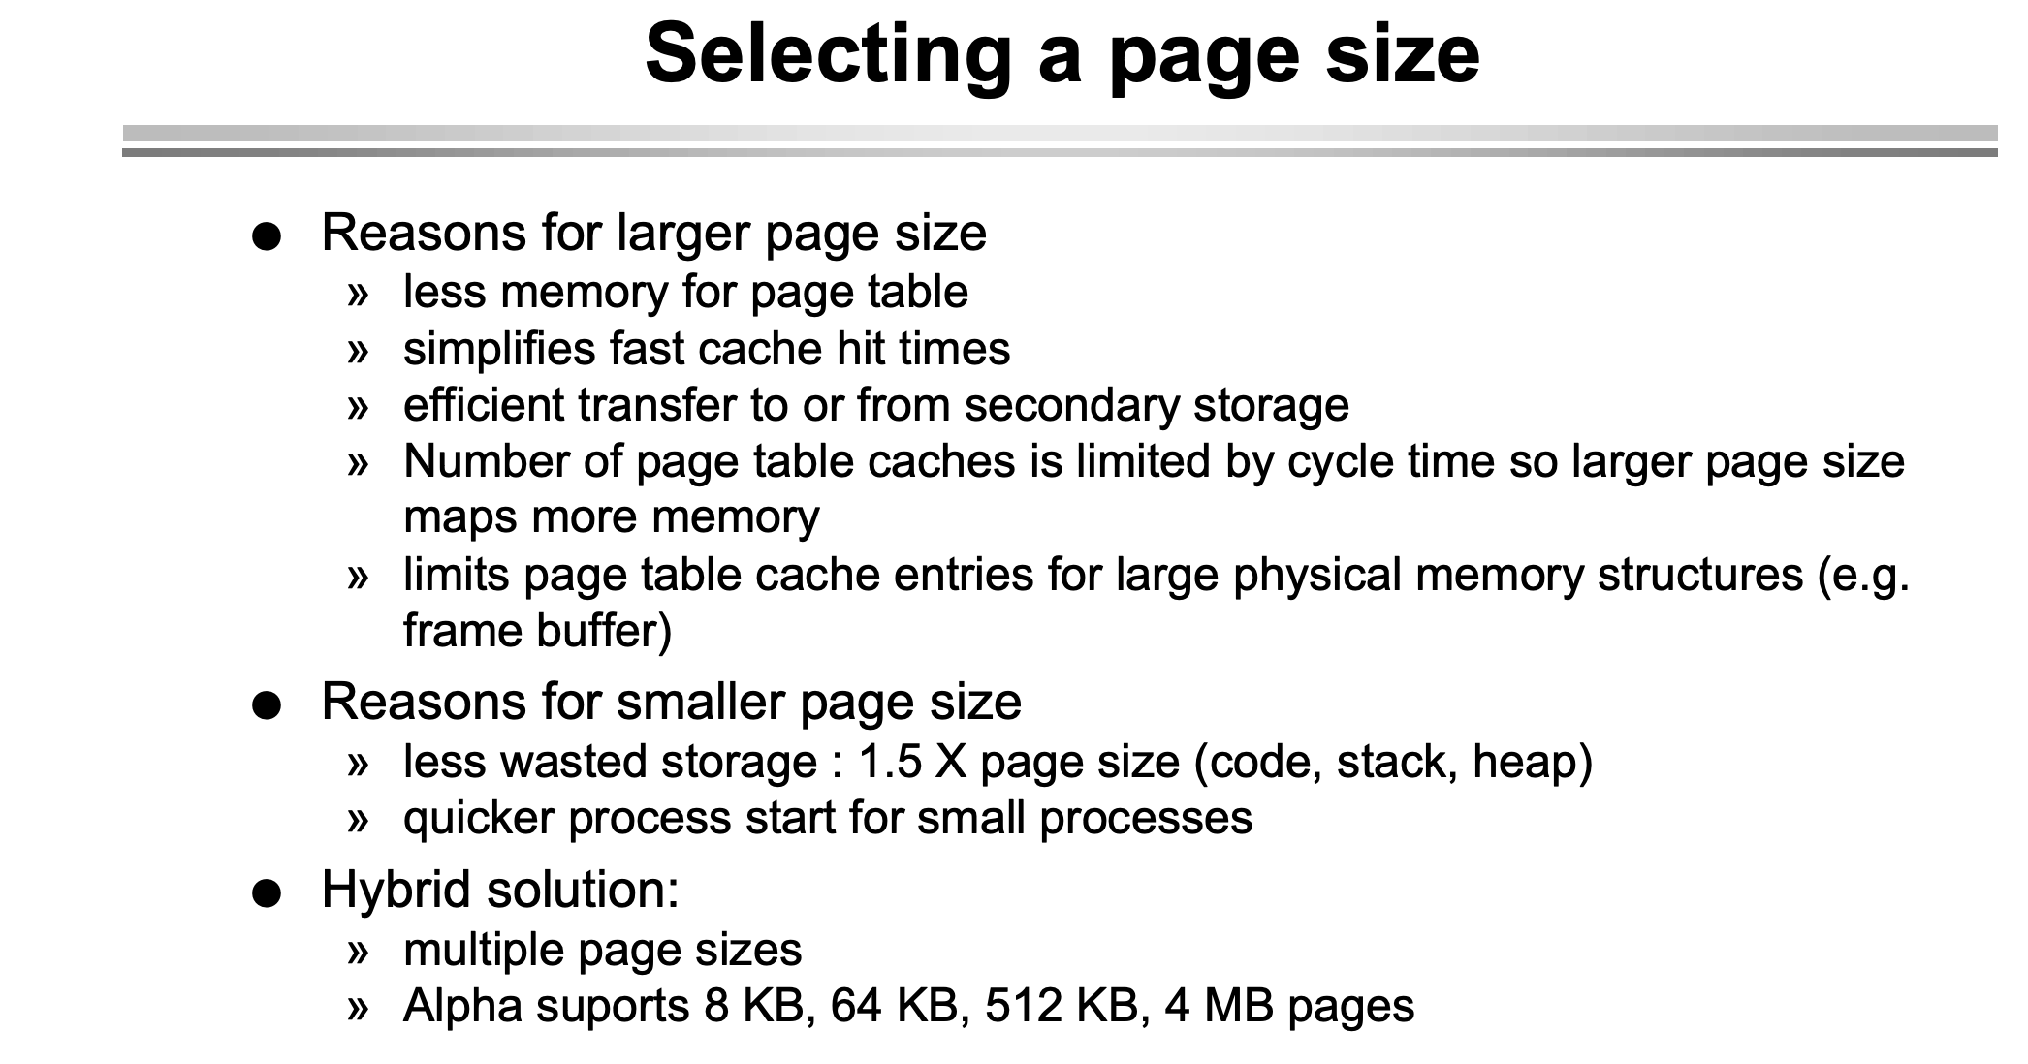
How to select Page Size?

Slide 42
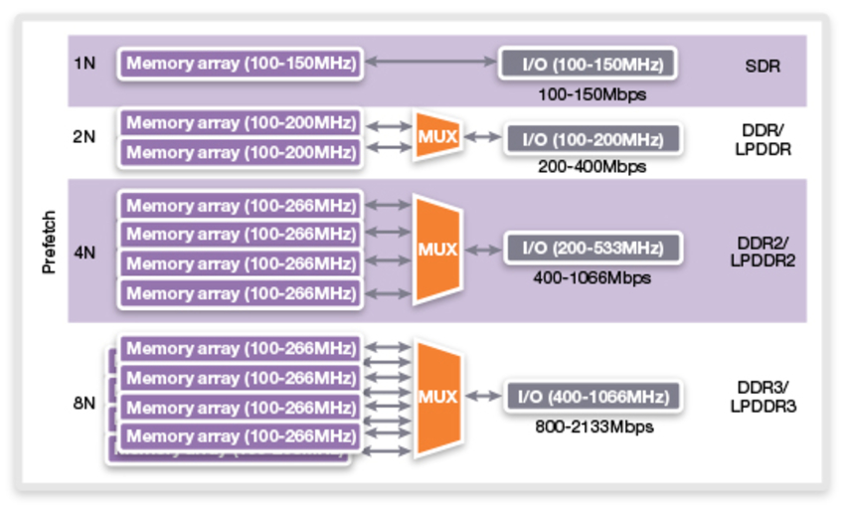
Prefetch
Prefetch is the term describing how many words of data are fetched every time a column command is performed with DDR memories.

Slide 43
Burst Length

Slide 44
Bank Group
The bank groups feature used in DDR4 SDRAMs was borrowed from the GDDR5 graphics memories.
DDR4 introduces the concept of Bank Groups that allows the system designer to build interleaved memory arrays down to the individual device level. For smaller systems which may have only a single memory device, this Bank Group feature can offer substantial benefits.
For example, one bank group can receive a series of pipelined commands for its upcoming data transfers. Once the first Bank Group starts its actual data transfers, another Bank Group can be initialized with its separate set of pipelined commands. After the first Bank Group completes its data transfers, the second Bank Group can initiate its data transfers, since it has already received its set of pipelined commands. In many cases, this Bank Group command pipelining can significantly reduce the impact of memory device delays, such as shown below.

Slide 45
No Bank Group vs Bank Group

Slide 46
tCCD_L vs tCCD_S

Slide 47
Bank Interleave
Bank interleaving, which represents a significant advantage for applications accessing random data. Bank interleaving can be extremely effective for concurrent operations and can hide the timing overhead that is otherwise required for opening and closing individual banks.
OFF: Banks are not interleaved, and address will be decoded as bank-row-column. ON: Banks are interleaved, and address will be decoded as row-bank-column.

Slide 48
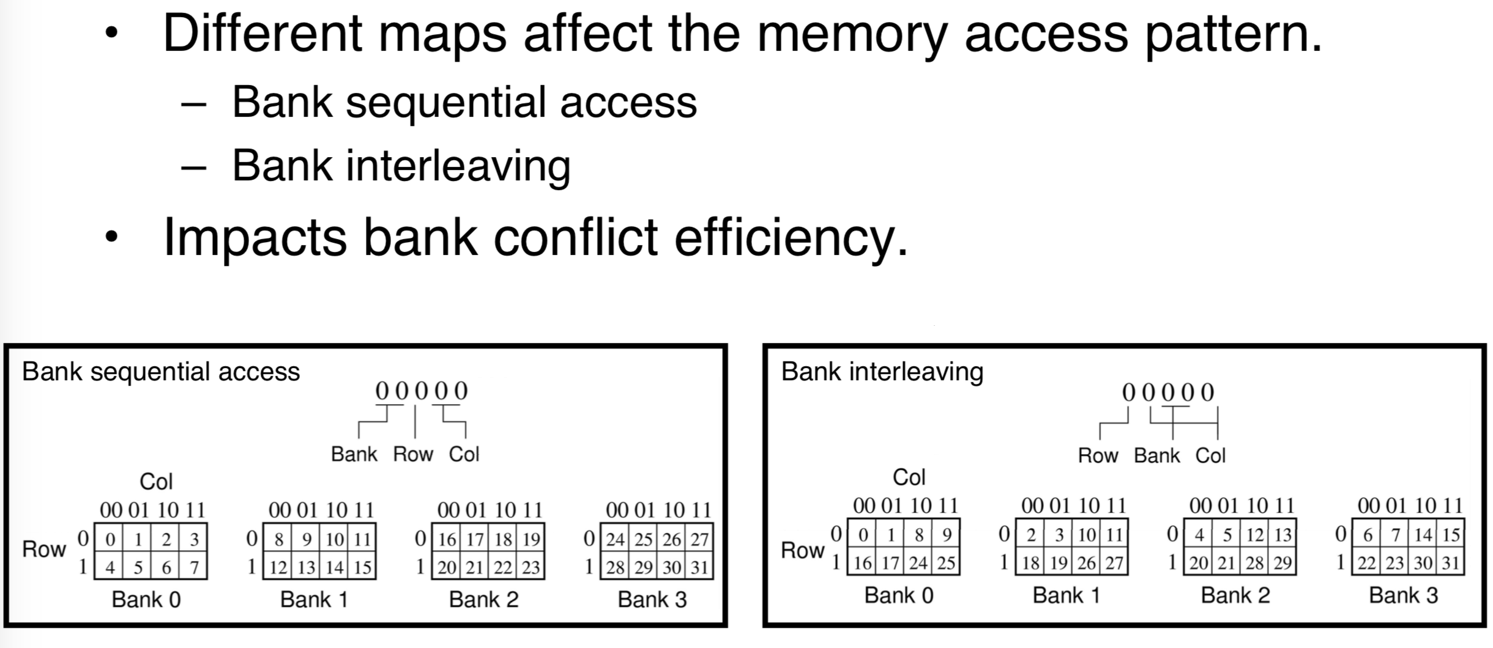
Advantage of bank interleave

Slide 49
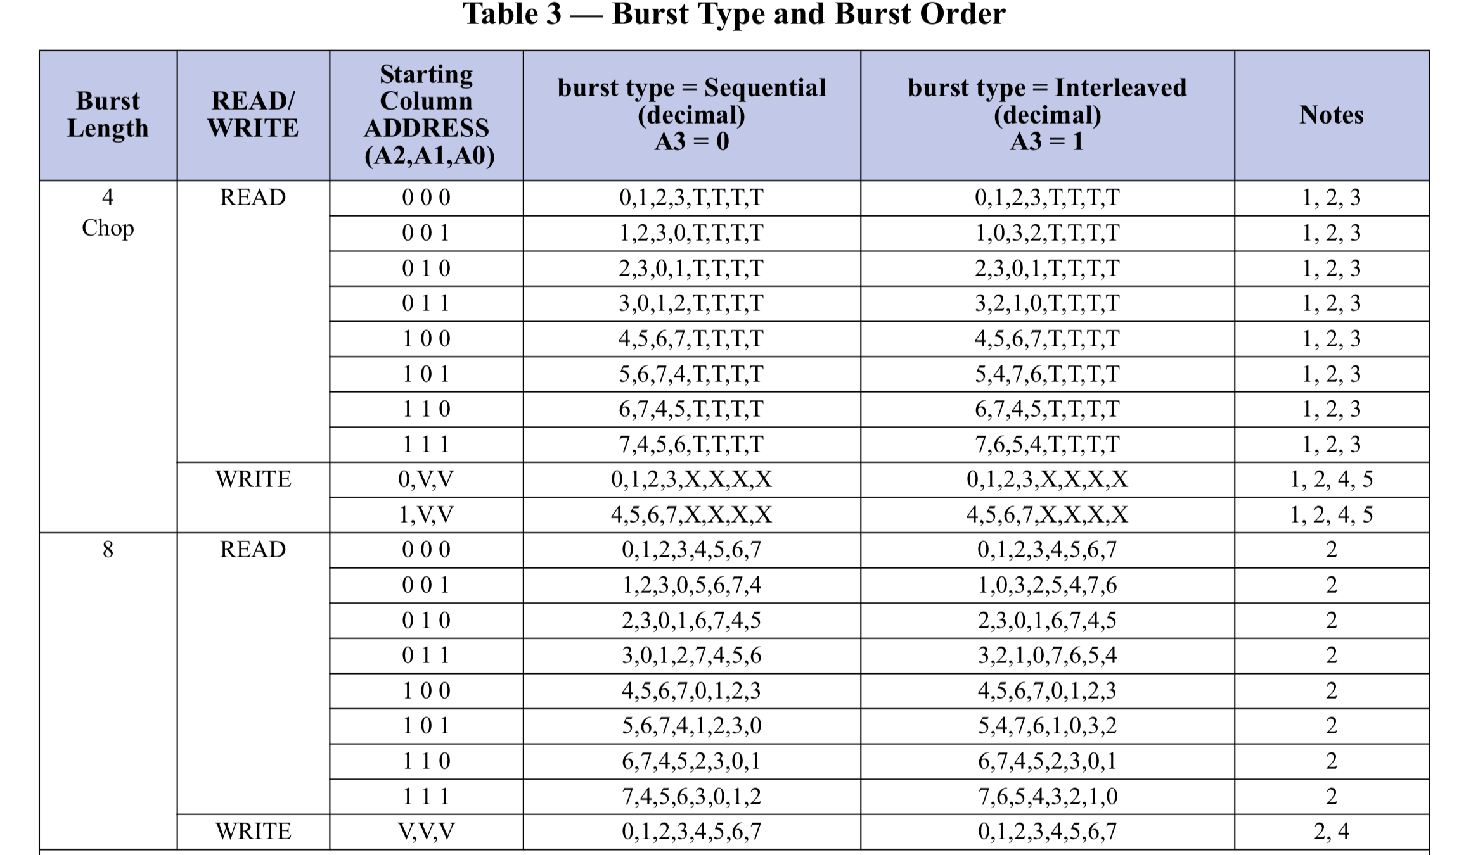
Burst Interleave
Burst Interleave is more efficient for some CPUs.

Slide 50
FSP
Easy to switch from one freq to another freq.
Used in LP4.

Slide 51
DLL
DDR3/DDR4 use DLL.
A DLL is used to maintain the timing relationship between a clock signal and an output data signal. A critical element of the DLL is the phase detector, which detects phase differences between the clock and output data.
LPDDR3/LPDDR4 don’t use DLL for low power.

Slide 52
Byte Mode(LP4)
JESD21-C
LP4 x16 → 2 x 8
Two bytes means byte mode.

Slide 53
BC4
Due to the 8n-prefetch architecture of DDR3, one burst must be 8 bits. Burst chop 4 (BC4) mode uses internal control signals to select only the first 4 bits of data to read or write. So, the entire command excution time for BL8 and BC4 is the same. If you are using a valid data cycle and total clock cycle to calculate efficiency, BC4 has a very low efficiency (lower than 50%). For a large data transfer and high-bandwidth application, BC4 is not suitable.
The only real benefit to the burst chop mechanism is that it allows better data bus utilization in dual rank memory systems, where the rank switching overhead may be shorter than the (same rank) burst chop idle time.

Slide 54
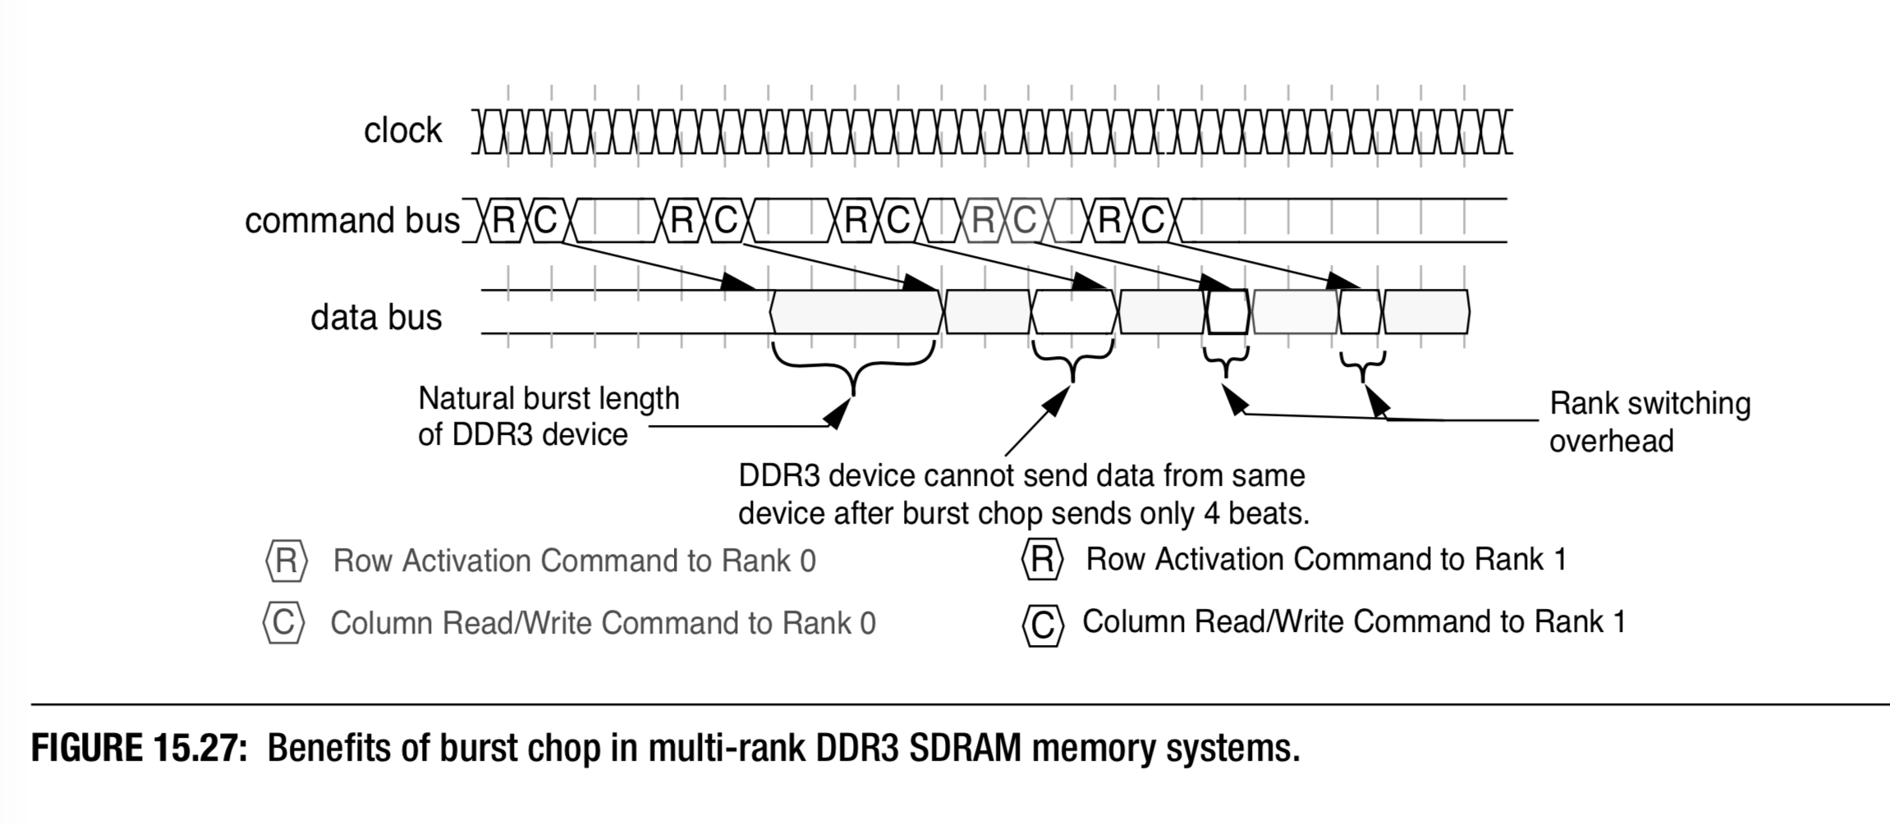
BC4 benifits in multi-rank system

Slide 55
Why Dram Freq 2667 not 2777?
From history, the base clock is 100M or 133M.
Dram freq is the multiple of the base clock.

Slide 56
What’s the initialized data of DRAM?
Jedec Spec don’t specified the initialized data of dram, it’s meaningless.

Slide 57
Why 9 tREFI?
tRFC min = 350ns, tREFI min = 3.9us.
3.9us / 350ns = 11.
9?

Slide 58
VDDQ Termination vs VSSQ Termination
LP4: VSSQ Termination;
LVSTL
PC4: VDDQ Termination.
POD12

Slide 59
Dram Package

Slide 60
A Die? B Die?
Different Types of Die.
Maybe 10nm, 20nm difference.

Slide 61
DIMM
A DIMM or dual in-line memory module comprises a series of dynamic random-access memory integrated circuits. These modules are mounted on a printed circuit board and designed for use in personal computers, workstations and servers.
DIMM is used to assemble bigger data width and bigger density dram.

Slide 62
The Types of DIMM
Unbuffered DIMMs (UDIMMs) -- Used mainly on desktop and laptop computers. Although they run faster and cost less, UDIMMs aren’t as stable as registered memory. Commands go directly from the memory controller residing in the CPU to the memory module.
Fully-buffered DIMMs (FB-DIMMs) – Usually used as main memory in systems that require large capacities, such as servers and workstations. FB-DIMMs use advanced memory buffer (AMB) chips to boost reliability, maintain signal integrity and improve methods to detect errors to reduce soft errors. The AMB bus is split into a 14-bit read bus and a 10-bit write bus. Having a dedicated read/write bus means reads and writes can happen at the same, which results in increased performance.
Registered DIMMs (RDIMMs) -- Also known as buffered memory, RDIMMs are often used in servers and other applications that require robustness and stability. RDIMMs feature onboard memory registers that are placed between the memory and the memory controller. The memory controller buffers command, addressing and clock cycling, and directs instructions to the dedicated memory registers rather than directly accessing the DRAM. Consequently, the instructions could take about one CPU cycle longer. However, the buffering reduces the strain on the CPU's memory controller.
Load-reduced DIMMs (LR-DIMMs) – Use isolation memory buffer (iMB) technology that buffers the data and address lanes, reducing the load on the memory controller. The iMB chip also buffers data signals, unlike the register on RDIMMs, which only buffers command, addressing and clock cycling. The iMB chip isolates all electrical loading, including data signals of the DRAM chips on the DIMM from the memory controller. As a result, the memory controller only sees the iMB and not the DRAM chips. The memory buffer then handles all the reads and writes to the DRAM chips, enhancing capacity and speed.
SO-DIMM -- While the standard DIMM is in the form of a rectangular stick approximately 5.5 inches in length, the small outline dual in-line memory module (SO-DIMM) is about half that size at 2.74 inches long. Both types of DIMMs are most commonly 1.2 inches tall, but both are made in a very low profile (VLP) format that is only 0.8 inches tall. SO-DIMM is mainly used for portable computing devices such as laptops and tablets. It differs from standard DIMM in that the DDR4 SO-DIMM has 260 pins versus 288 pins for the DRR4 DIMM. Standard DIMMs are used in PCs and servers. The VLP DIMM was developed to meet the space requirements of blade servers.

Slide 63
Lead-Free and RoHS
RoHS (Restriction of Hazardous Substances) is a European Union directive that restricts the use of lead, mercury, cadmium, chromium (VI), PBBs, and PBDEs in electrical and electronic equipment as of July 1, 2006.
Due to environmental concerns, the need for lead-free solutions in electronic components and systems is receiving increasing attention within the semiconductor and electronics industries. Maxim Integrated is committed to working with our customers to be able to offer products which meet their specific needs while complying with RoHS legislation.

Slide 64
Dram Training

Slide 65
Why dram needs training?
If layout is very good, the trace length and the length of all Pin’s layout are equal, dram signals are started and arrived at the same time, no need training.

Slide 66
Dram Features

Slide 67
Loopback Mode
DDR5.

Slide 68
Target Row Refresh
Row Hammer.
It’s fixed by DRAM itself.

Slide 69
Read Mask
SDR SDRAM uses Read Mask, it‘s phased out after DDR SDRAM.

Slide 70
Command Address Latency(CAL)
DDR4 also offers programmable Command-to-Address Latency that can be used to improve system power efficiency.

Slide 71
Read Leveling
DQ-DQS delay.
PC3:
Read leveling is a specification that adjusts the output skew from each DRAM on the controller side. Since DDR3 operates at high speed, correct data input may not be possible without timing adjustment.
In addition to the memory array, a ROM that retains specific data patterns is provided. The MPR function intended to assist the read leveling outputs data from the ROM.
The specific data patterns enable timing adjustment during READ operation. Note: To use MPR, the controller side must be compatible with MPR.

Slide 72
Burst Interrupt
An efficient pipeline of multiple column reads is already possible by simply sending multiple read commands spaced as closely as the desired burst length dictates.
https://en.wikipedia.org/wiki/Synchronous_dynamic_random-access_memory#Interrupting_a_read_burst

Slide 73
ECC
DDR5/LPDDR5 support ECC.

Slide 74
Deep Sleep Mode
LPDDR5: DSM Mode.

Slide 75
Write X
LP5.

Slide 76
DVFS
LP5:

Slide 77
WCK
LP5:

Slide 78
Clock Stop Mode
The clock can be stopped if no DRAM operations are in progress that would be affected by this change. Any DRAM operation already in process must be completed before entering clock stop mode.
This feature increases power savings by having fewer transitions on the clock path. There are predominantly two methods used to achieve this according to Micron Technology:
Changing the clock frequency when the data transfers require a different rate of speed, or,
Holding CKE HIGH, with CK LOW and CK HIGH for the full duration of Clock Stop Mode
The method being used is based on an individual product’s requirements. Mobile DDR memory can change the clock frequency during operation, but this is only allowed when all the timing and memory refreshing requirements are met.
According to JEDEC, the clock can even be stopped completely under the following conditions:
The last command (ACTIVE, READ, WRITE, PRECHARGE, AUTO REFRESH or MODE REGISTER SET) has executed to completion, including any data-out during read bursts; the number of clock pulses per access command depends on the device’s AC timing parameters and the clock frequency.
The related timing conditions (tRCD, tWR, tRP, tRFC, tMRD) have been met.
CKE is held High.

Slide 79
Test Mode
PC3:
The normal operating mode is selected by MR0 (bit A7 = 0) and all other bits set to the desired values shown in Figure 2.3.2. Programming bit A7 to a ‘1’ places the DDR3 SDRAM into a test mode that is only used by the DRAM Manufacturer and should NOT be used. No operations or functionality is specified if A7 = 1.

Slide 80
Low Power

Slide 81
IDD
What’s IDD?
The current draw from the VDD terminal of the device (the IDD).

Slide 82
AXI
AXI to DRAM

Slide 83
Cache Line

Slide 84
Dram Error

Slide 85
Bit Flip will cause crash?
Maybe, maybe not.
Consider that many data file, eg: audio, movie, text file, if one bit flip occurs, the instructions are normal, so the system may be work normally!

Slide 86
Reference
Google Search.
Wiki.

